Slide 1

International Conference of Advancement in Interdisciplinary Research
on
“DATA DEDUPLICATION AND ATTRIBUTE BASED ENCRYPTION IN CLOUD”
PRESENTED BY :
AMBIKA GUPTA
NISHI CHAUDHARY
GLA UNIVERSITY, MATHURA

Slide 2
Abstract
The definition of nowadays is with the data all around, there is a lot of data regarding each fellow. There are many platforms to handle this data, but when it comes to similar data it is difficult to distinguish between multiple files whether two files are similar or not. When we upload the files or folders on the cloud then there may be some files that are repeated in the storage, to remove the duplicate files and maintain the security of files by encrypting the files we have proposed this paper in which we do the encryption and decryption based on attributes. Attributes are the specific credentials of the users with whom the uploaded files will be shared. The attributes are selected by the provider who will outsource his data on the cloud and want to share with the users matching with the same attributes.

Slide 3
Agenda
Problem Statement
Solution
Objective
Data Deduplication
Attribute based Encryption
Project Structure
Work Flow
Encryption and Decryption
Glimpse of Project
Conclusion and Future Scope
Reference

Slide 4
Problem Statement
Our problem is categorised into two parts:
1. Duplication in the cloud
Redundancy of Data.
Network Bandwidth
Storage Consumption
2. Authentication and security
Access Controls
Encryption based on group policies

Slide 5
Solution
Data Deduplication
Attribute based Encryption
We are implementing both deduplication and attribute based encryption in the cloud so as to solve the above discussed problem

Slide 6
Objective
Reduce the storage overhead by eliminating redundant files from the cloud
Optimise the network bandwidth over the public network while not uploading the same files again
Security over the stored data on the basis of attributes

Slide 7


Data Deduplication
Client-side deduplication

Slide 8
What is Deduplication?
Deduplication refers to the elimination of duplicate and redundant data
Backup of data, whose copies only changed data
Different users upload multiple files on the cloud and many of them are the duplicate files.
The different cloud providers provides the facility to users to upload their data on the cloud for accessibility and availability
The data stored on the cloud can be redundant data, and can occupy extra space
To eliminate same files and store different files or updated files, we use deduplication in the cloud

Slide 9
Attribute-based encryption
Public key encryption

Slide 10
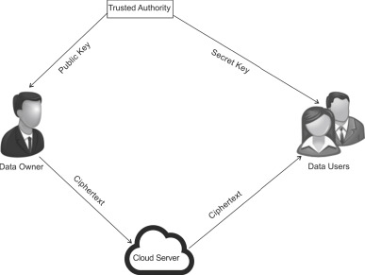
Attribute based Encryption
Public-key encryption in which the secret key of a user and the ciphertext are dependent upon attributes.
A crucial security aspect of attribute-based encryption is collusion-resistance.
It can be used for log encryption.
Key-policy attribute based encryption
Ciphertext-policy attribute based encryption
Fig 1. Attribute based Encryption

Slide 11
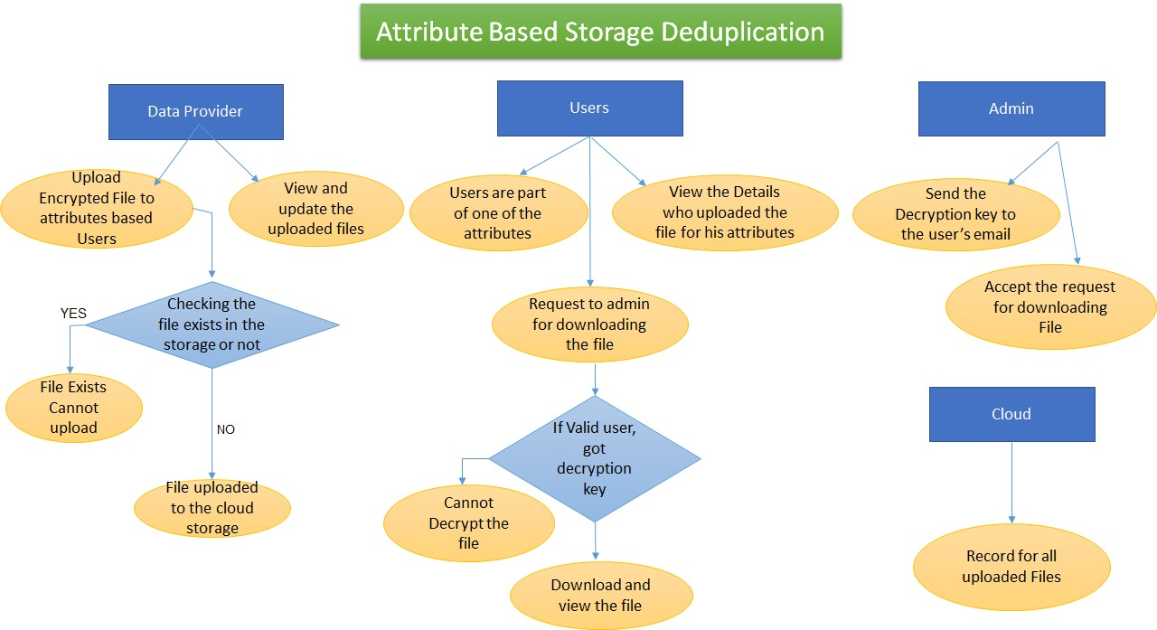
Project Structure
Fig 2. Structure of the website

Slide 12
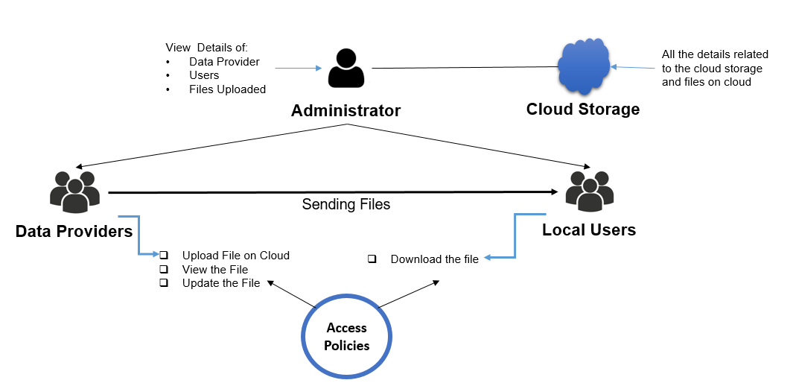
Work Flow
Fig 3. Access policies provided to the roles

Slide 13
Encryption and decryption
Aes encryption

Slide 14
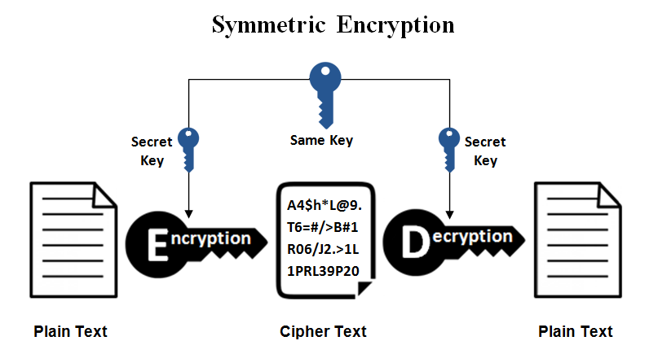
Symmetric Key Encryption
Symmetric encryption is a type of encryption where only one key (a secret key) is used to both encrypt and decrypt electronic information
The entities communicating via symmetric encryption must exchange the key so that it can be used in the decryption process
This encryption method differs from asymmetric encryption where a pair of keys, one public and one private, is used to encrypt and decrypt messages
Also known as private key encryption
Fig 4. Symmetric Key Encryption

Slide 15
Examples of Private Key Encryption
AES (Advanced Encryption Standard)
DES (Data Encryption Standard)
IDEA (International Data Encryption Algorithm)
Blowfish (Drop-in replacement for DES or IDEA)

Slide 16
Why AES?
AES is the short form of Advanced Encryption Standard.
It is FIPS approved cryptographic algorithm used to protect electronic data.
It is symmetric block cipher which can encrypt and decrypt information.
Encryption part converts data into cipher text form while decryption part converts cipher text into text form of data.
AES algorithm used different keys 128/192/256 bits in order to encrypt and decrypt data in blocks of 128 bits.
AES is implemented in both hardware and software to protect digital information in various forms data, voice, video etc. from attacks or eavesdropping.

Slide 17
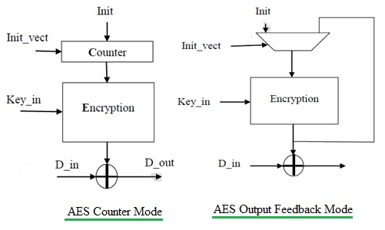
Advanced Encryption Standard
The picture depicts two modes of AES algorithm viz. CTR (counter) mode and OFB (Output Feed Back) mode.
In CTR (counter) mode, the output of the Counter is the input for the Encryption core and an initialization vector is used to initialize the counter.
In OFB mode, the output of the Encryption operation is fed back to the input of the Encryption Core.
Fig 5. Advanced Encryption Standard

Slide 18
Glimpse of the project
Project working

Slide 19
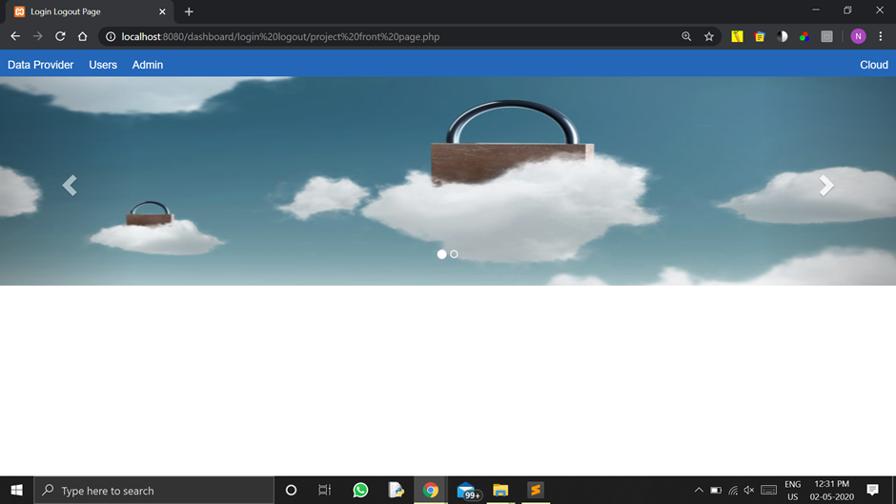
Main page of the website
The all three parties can login to their portals; Data Provider, User and Administrator. On thr right hand side the cloud related details are there which can be access only by the cloud administrator

Slide 20
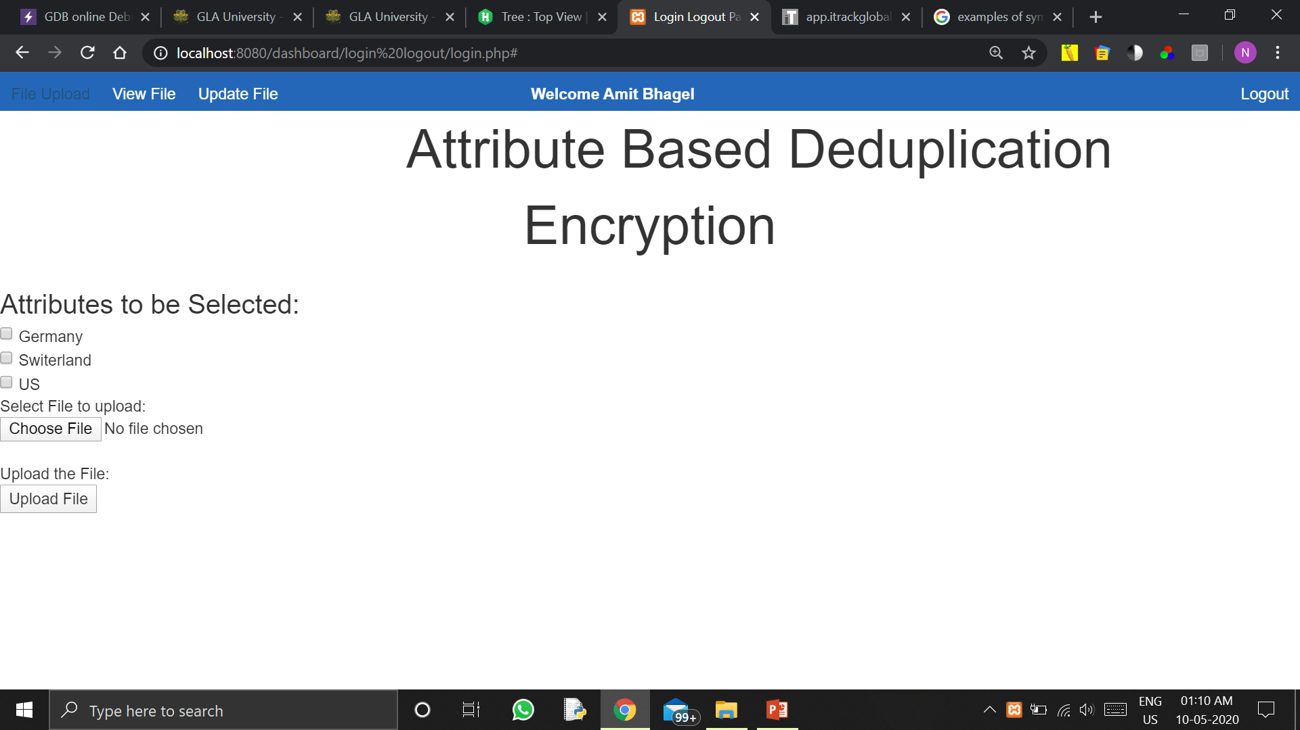
Data provider portal
Data Provider uploading the files to the specified attributes related with the country. The data owner will choose the attributes to whom he wants to share the data with.

Slide 21
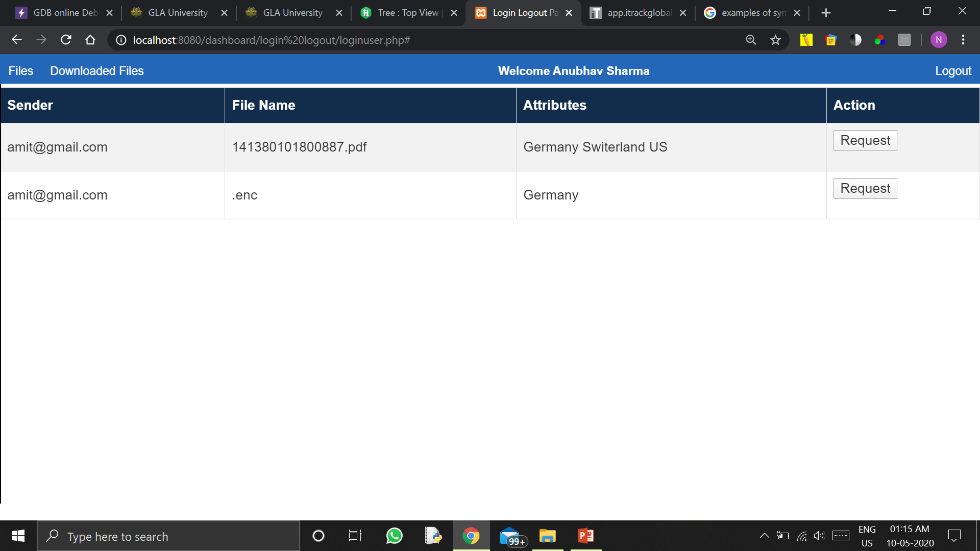
User portal displaying uploaded files
This is the user portal where he can view the entries of the files uploaded for him and also view that who have get those files like other attributes. He will be requesting for the file to be downloaded. The request is forwarded to the Administrator and then the admin forward the decrypt key and the user can decrypt the file and view it as plsin text.

Slide 22
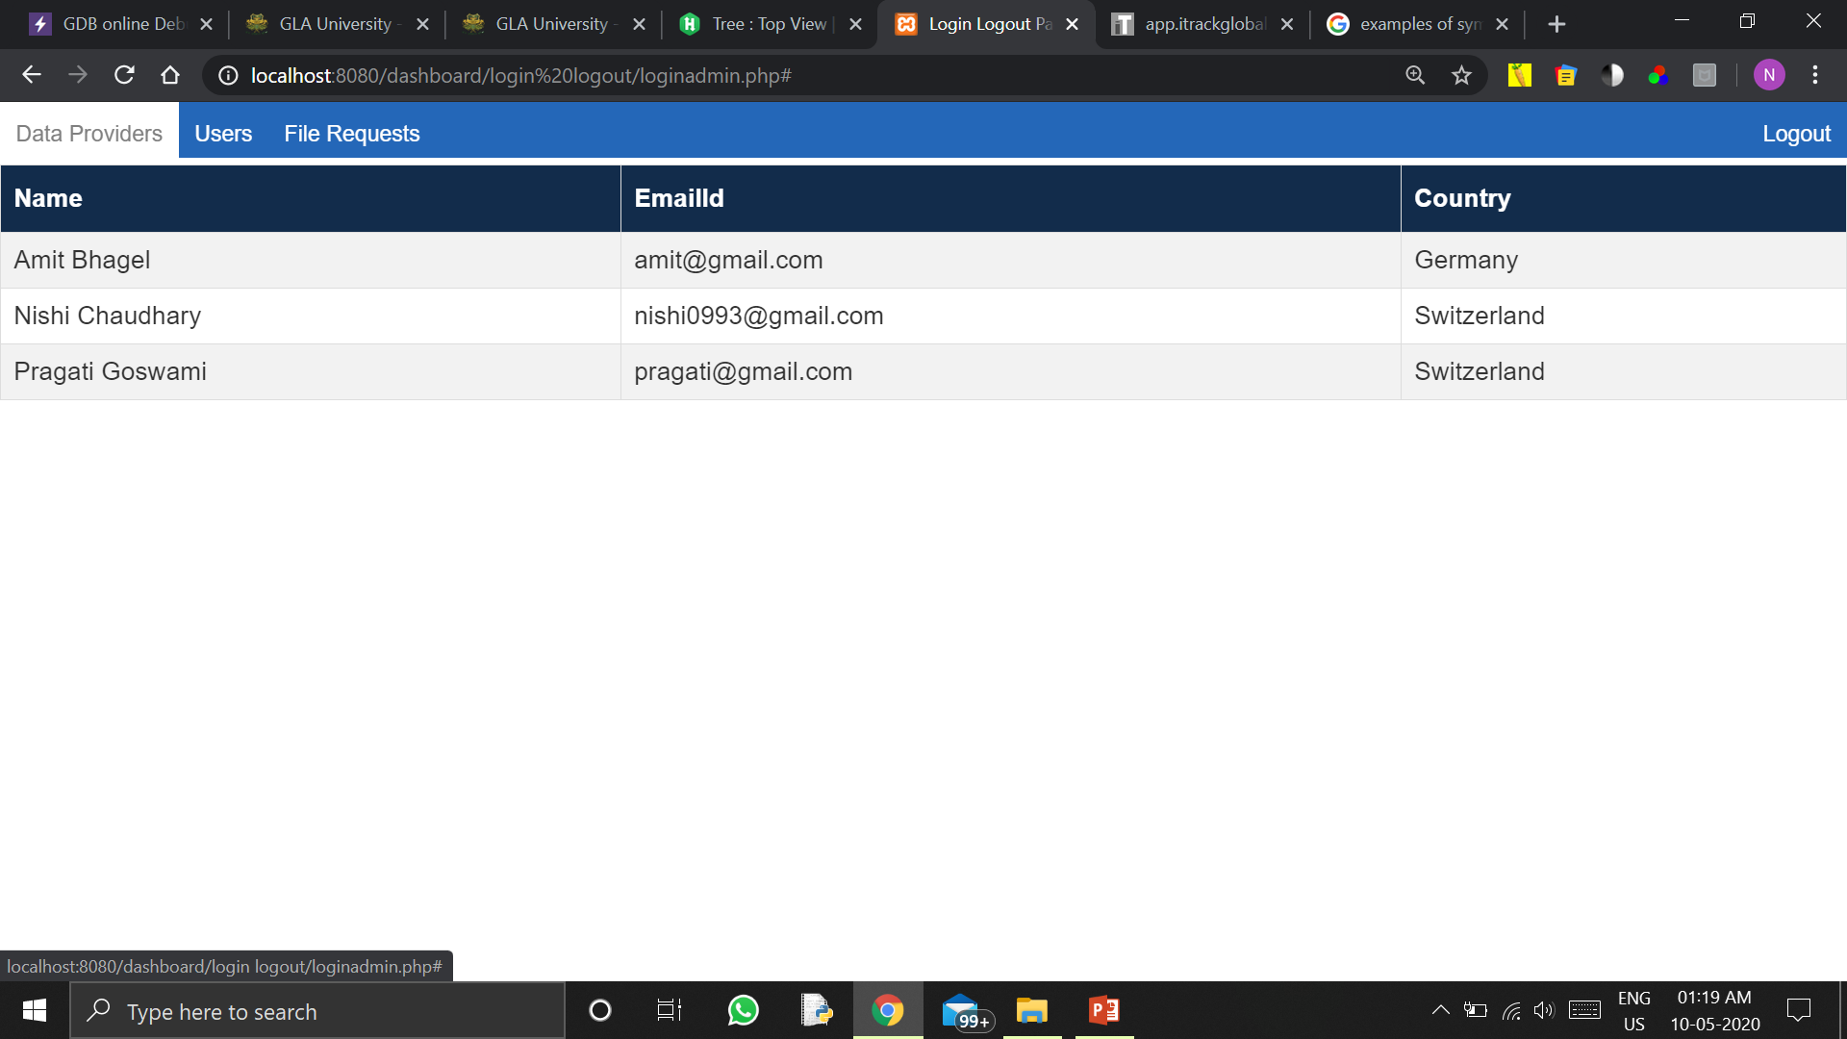
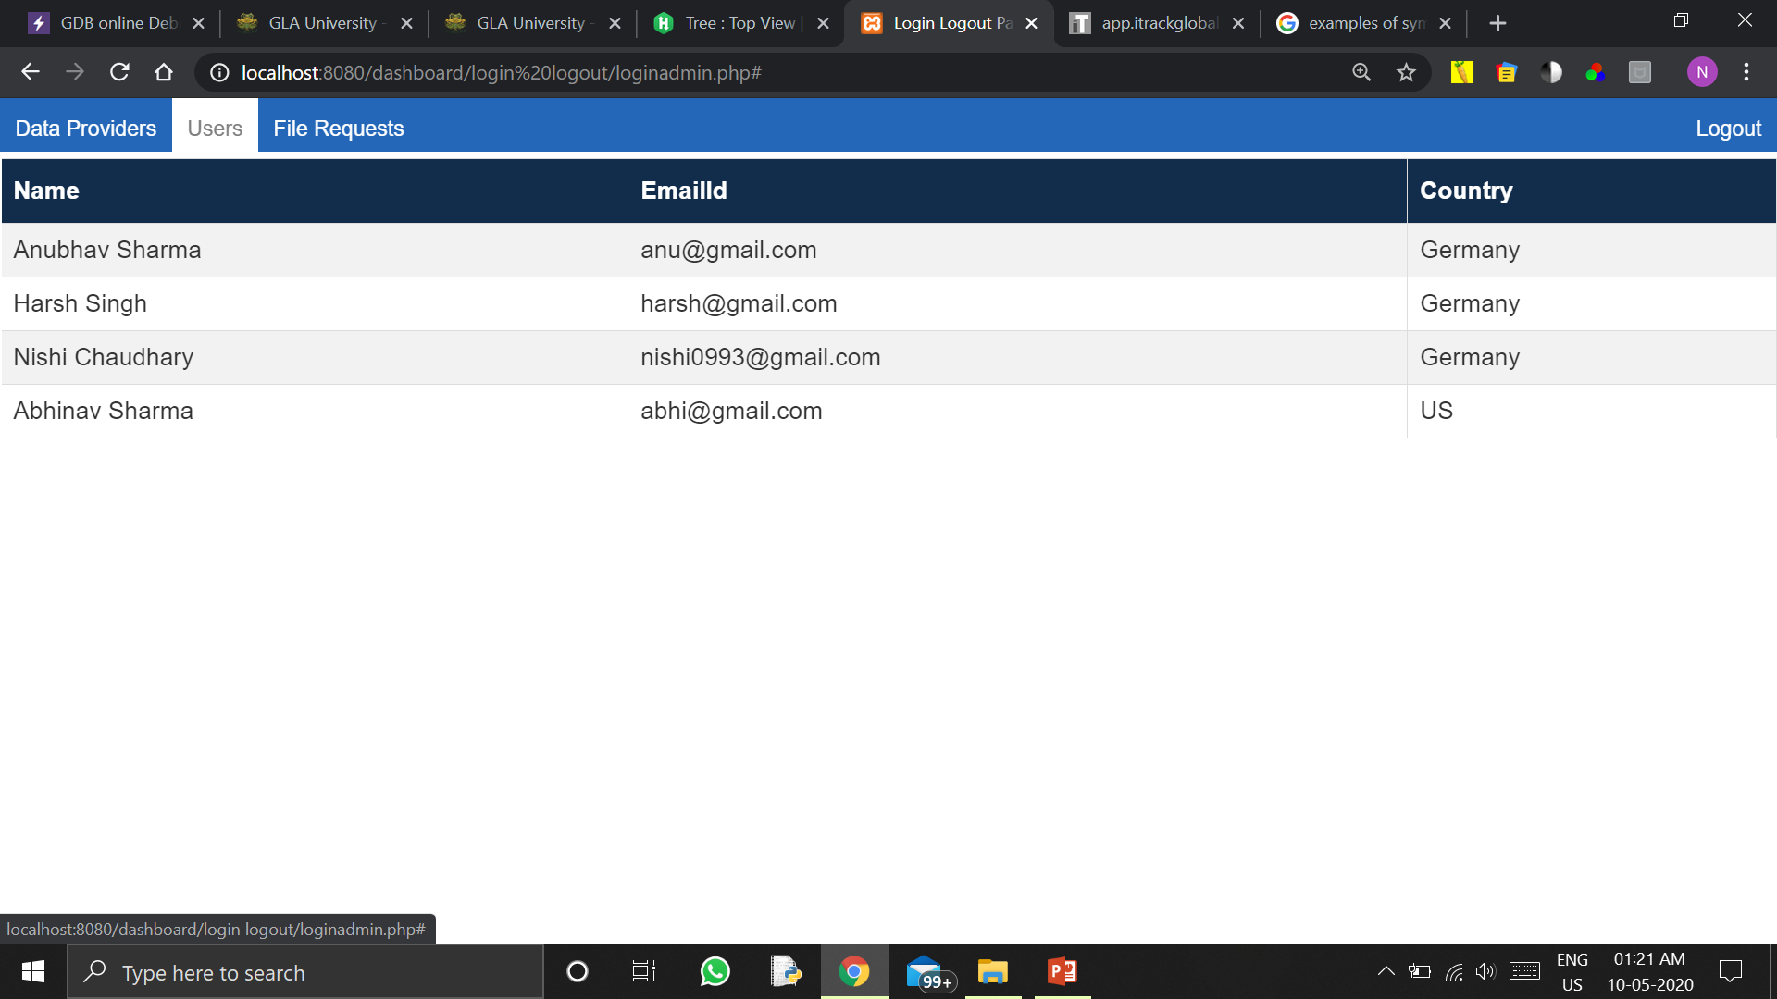
Admin Portal Displaying Details
The details of the data providers and the users are being displayed to the administrator on his portal.

Slide 23
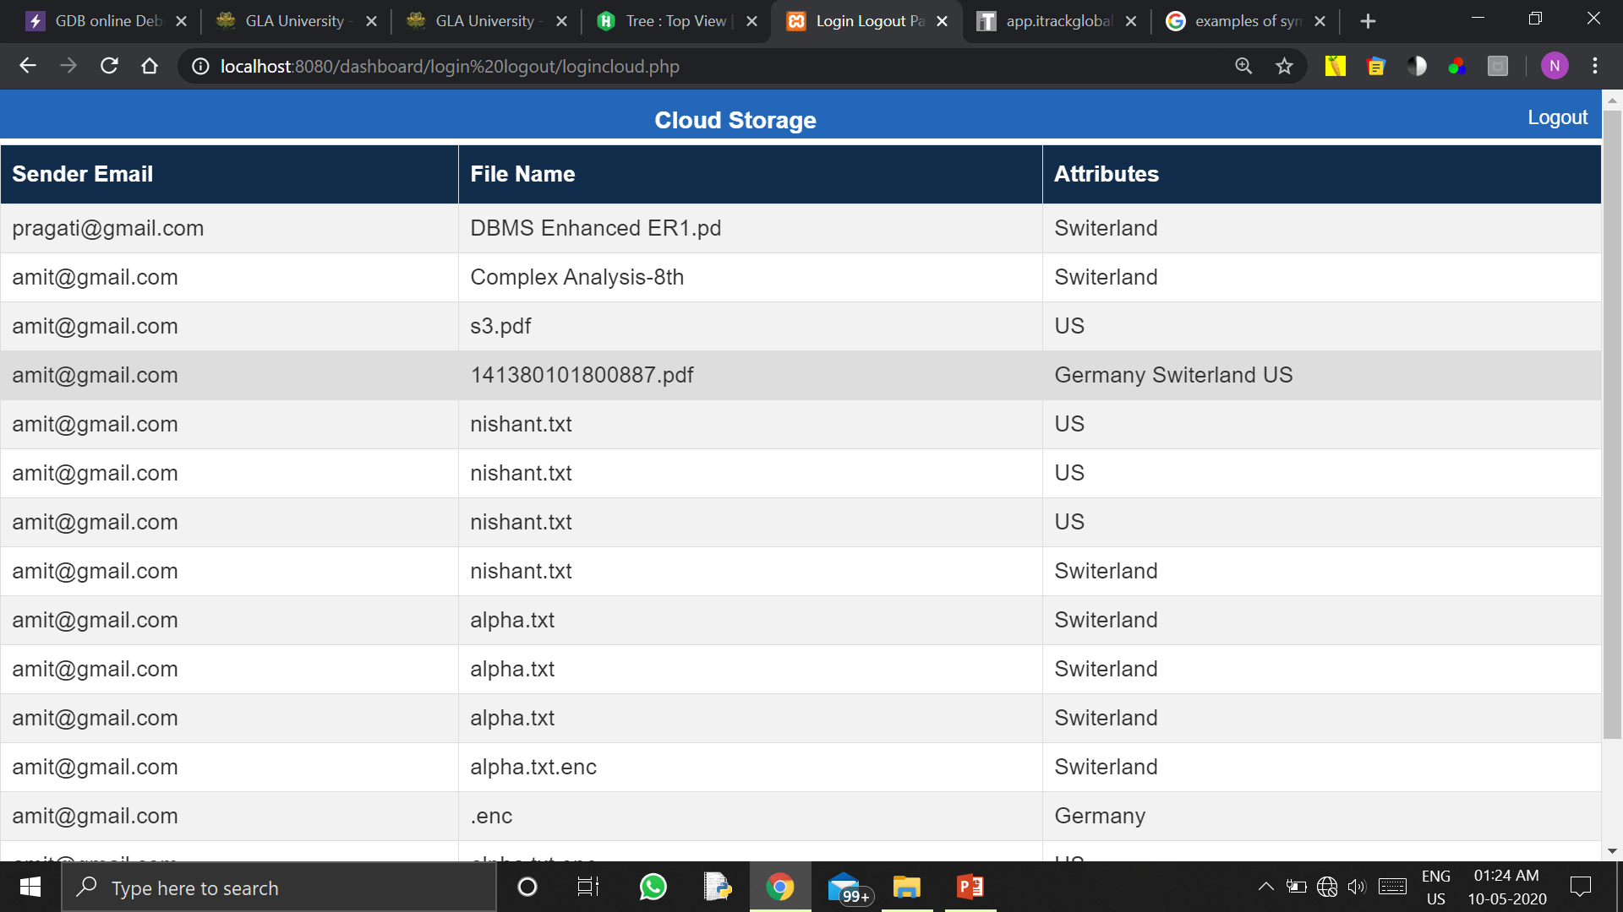
Cloud Storage
It is the cloud administrator who can view the entries of the files uploaded on the cloud server.

Slide 24
Literature Review
Hui CUI, Robert H. DENG et al. [3] proposes a secure system which can remove the deduplication in the hybrid environment. They discuss the outsourcing of the data by the provider and the removing the duplication of files in the cloud.
Naga Malleswari TYJ and Vadivu G [4], they discuss the existing techniques of deduplication like fixed length of data, variable length of data, and block deduplication of data. Their implementation in the public cloud and comparison with the existing techniques of deduplication.
R. SHOBANA, K. SHANTHA SHALINI et al. [5] describe in their paper about the removing duplicate and identical data which is heavily used in public cloud storage so as to minimize the storage and save network bandwidth. To maintain the confidentiality of data which is sensitive during removing of the duplication, one encryption method is used to encrypt the data.
According to Peter Schoo, Volker Fusenig et al. [2] there are some challenges in the cloud security network which are discussed in their paper. The challenges are grouped in various categories like content protection in public cloud, distribution transparency control, security in virtual technology, and secure the private operations. There are many benefits of cloud networking in respect with the cloud operators and users.
B. Tirapathi Reddy, U.Ramya, Dr.M.V.P Chandra Sekhar et al. [1] discuss about the deduplication in cloud as according to them in future cloud storage will be playing an essential role for all remote users, as it helps in reducing the overhead of data management and minimization of storage cost. They introduced the concept of tokens for the duplicate files which are generated by the cloud server having secret keys, and also they discussed about the duplication check in the hybrid environment.
Arvind Kumar Maurya, Avinash Singh, Unnati Dubey2 Shivansh Pandey and Upendra Nath Tripathi et al. [16] proposed a method to encrypt a transparent data and files to prevent unauthorized access to data by restoring the files from anther server. Increasing level of security by encrypting and decrypting data files, log files, backup files without dissolving transparent properties for its users. Applied distributed and encrypted techniques to protect from data loss.
According to K. V. Pradeep, V. Vijayakumar, and V. Subramaniyaswamy et al. [17] the data accessed or shared through any device from cloud environment has security concerns like Identity Access Management, hijacking an account or services by internal or external intruder are challenges in cloud environment. Provider has full access to data and key, client cannot trust data provider completely. Author proposed framework to share file in secure public key infrastructure. File shared among users is protected using CKMS ensure authenticity from internal and external users. Key is distributed among users using key transfer protocol.
Yeshwanth Rao Bhandayker et al.[18] describes the challenges and trends in the cloud computing as lots of new brand technologies like mobile technology and emerging to mobile cloud computing, cloud containers are emerging at a quick pace so one need to be highly cautious to recognise security threats and challenges in making use of new technologies. Cloud provider should educate client about the degree of security used.

Slide 25
Conclusion and Future Scope
In this project we have simulated the deduplication in the cloud applying attribute based encryption. The consumption of network bandwidth and storage is being optimised by this implementation. We discuss the importance of deduplication in the cloud and its need. Also we discuss what attribute based encryption means and how do it works in the cloud computing. We learn about the symmetric and asymmetric encryption. We use AES algorithm for the encryption and decryption of the files shared between the sender and receiver.
We try to implement it using the public cloud and doing all the operations on the private end.
The purpose of this project is to have a better understanding of the deduplication and ABE. How they can be used in the cloud to optimise the cloud resources. The website is now a static website. In future we will be using it as a dynamic website and it can be used by the users to share the files among them.
Also we will be adding some security features in future for securing our website from following cyber-attacks like: SQL injections, Cross-site scripting, Credentials Brute Force Attacks, Website malware infections and attacks, etc. We are also looking for creating its application for the public use.

Slide 26
References
[1]. B. Tirapathi Reddy, U.Ramya and Dr.M.V.P Chandra Sekhar (2016). “A comparative study of data deduplication techniques in cloud storage” International Journal of Pharmacy & Technology, ISSN: 0975-766X.
[2]. Peter Schoo, Volker Fusenig, Victor Souza, Márcio Melo, Paul Murray, Hervé Debar, Houssem Medhioub, Djamal Zeghlache (2010). “Challenges for Cloud Networking Security” International ICST Conference on Mobile Networks and Management, HP Laboratories HPL: 2010-137.
[3]. Hui CUI, Robert H. DENG, Yingjiu LI, Guowei (2017). “Attribute-based storage supporting secure deduplication of encrypted data in cloud” Published in IEEE Transactions on Big Data, 2017 January, 10.1109/TBDATA.2017.2656120.
[4]. Naga Malleswari TYJ and Vadivu G (2019). “Adaptive deduplication of virtual machine images using AKKA stream to accelerate live migration process in cloud environment” Journal of Cloud Computing: Advances, Systems and Applications, 8:3.
[5]. R. SHOBANA, K. SHANTHA SHALINI, S. LEELAVATHY and V. SRIDEVI (2016). “DE-DUPLICATION OF DATA IN CLOUD” Department of Computer Applications, Aarupadai Veedu Institute of Technology, Vinayaka Missions University, CHENNAI (T.N.) INDIA, 6, 2933-2938 ISSN 0972-768X.
[6]. AES, URL:” https://proprivacy.com/guides/aes-encryption”.
[7]. Advanced Encryption Standard, URL:”https://en.wikipedia.org/wiki/Advanced_Encryption_Standa rd”.
[8]. PHP Symmetric encryption and decryption of large files, URL: “https://riptutorial.com/php/example/25499/symmetric-encryption-and-decryption-of-large-files-with-openssl”.
[9]. Uploading file on DriveHQ, URL: “https://www.drivehq.com/bbs/getmsg.aspx/bbsID110/msg_id5988980/page28#5988980”.

Slide 27
[10]. Download file, URL: “https://www.phptpoint.com/how-to-download-file-in-php/”.
[11]. Cipher text-Policy ABE, URL: “https://crypto.stackexchange.com/questions/17893/what-is-attribute-based-encryption”.
[12]. Changji Wang and Jianfa Luo (2013). “An Efficient Key-Policy Attribute-Based Encryption Scheme with Constant Cipher text Length” International Conference on Computational Intelligence and Security (CIS2012), Article ID 810969.
[13]. Cipher test-policy, URL: “https://www.cs.utexas.edu/~bwaters/publications/papers/cp-abe.pdf”.
[14]. Duplication in Cloud, URL: “https://nektony.com/duplicate-finder-free/remove-duplicate-photos-in-icloud”.
[15]. AES encryption, public and private keys, URL: “https://stackoverflow.com/questions/273396/aes-encryption-what-are-public-and-private-keys”.
[16]. http://compmath-journal.org/dnload/Arvind-Kumar-Maurya-Avinash-Singh-Unnati-Dubey-Shivansh-Pandey-and-Upendra-Nath-Tripathi/CMJV10I01P0190.pdf
[17]. https://www.hindawi.com/journals/jcnc/2019/9852472/
[18]. N Subramanian, A Jeyaraj - Computers & Electrical Engineering, 2018 – Elsevier
[19].https://www.google.com/url?sa=t&rct=j&q=&esrc=s&source=web&cd=3&ved=2ahUKEwjO3L3BzpDpAhUZzTgGHXfGCewQFjACegQIDRAD&url=https%3A%2F%2Fwww.ijcsmc.com%2Fdocs%2Fpapers%2FMay2017%2FV6I5201741.pdf&usg=AOvVaw0YEP9yAcfJbg9jwM1DVAf3.

Slide 28
Any Question?
Thank You

